Slide 1
Convolutional Neural Networks vs. Convolution Kernels: Feature Engineering for Answer Sentence Reranking
Kateryna Tymoshenko†
Daniele Bonadiman†
Alessandro Moschitti

Slide 2
MOTIVATION
Methods for automatizing feature engineering are remarkably important in commercial applications

Slide 3
TASK INTRODUCTION
A1:Owls are a group of birds that belong to the order Strigiformes
A2:Most are solitary and nocturnal , with some exceptions
A3:Owls hunt mostly small mammals , insects , and other birds , although a few species specialize in hunting fish
Q/A1
Q/A2
max
A1
Q:what bird family
is the owl?
Q/A3

Slide 4
TREE KERNEL
TK<T1,T2> ——> value
T1,T2 are trees (syntactic tree/semantic tree)
value is the similarity score

Slide 5
SYNTACTIC TREE
NP
NP
NP
NP
NP
D
N
D
N
D
N
D
N
D
N
a
dog
a
dog
a
dog
NP
NP
NP
NP
NP
D
N
D
N
D
N
D
N
D
N
a
cat
a
cat
a
cat

Slide 6
SEMANTIC TREE
Predicate-Argument Structures (PAS)
S1: Mike got a gift.
PAS
rel
Arg1
Arg2
get
mike
gift

Slide 7
SEMANTIC TREE
S2: Mike got a gift that his mother bought.
S2: Mike got a gift that his mother bought.
PAS
PAS
PAS
rel
Arg1
Arg2
rel
Arg1
Arg2
rel
Arg1
Arg2
R-Arg2
get
mike
PAS
get
mike
PAS
buy
mother
gift
that
rel
Arg1
Arg2
R-Arg2
buy
mother
gift
that

Slide 8
Feature Engineering for QA with CTKs
1.Converting two texts into a richer structural representation based on syntactic and semantic structures (CH).
2.Applying CTKs.

Slide 9
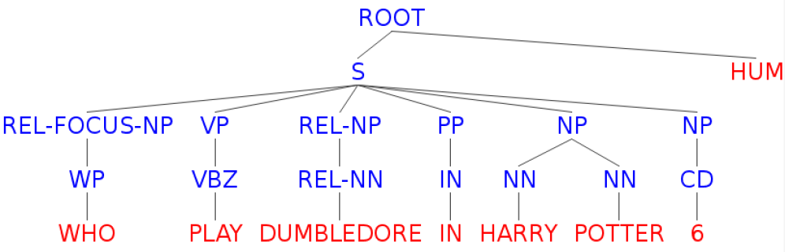
Shallow Representation
Chunk
Pos Tag
Lemma

Slide 10
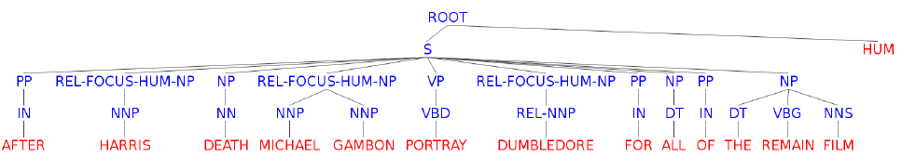
Shallow Representation
Enrich the representaton with question class and question focus.
Q
A

Slide 11
Reranking with Tree Kernels
<P1,P2>
<P1,P3>
<P1,P4>
<P2,P1>
<P2,P3>
......
<P4,P1>
<P4,P2>
<P4,P3>
P1
P2
P3
P4
P3
P2
P1
P4
Re-ranker
P3

Slide 12
Reranking with Tree Kernels
(<QA1*,QA2>,1)
(<QA1*,QA3>,1)
(<QA1*,QA4>,1)
(<QA2,QA1*>,0)
(<QA2,QA3>,0)
......
(<QA4,QA1*>,0)
(<QA4,QA2>,0)
(<QA4,QA3>,0)
(QA1*,1)
(QA2, 0)
(QA3, 0)
(QA4, 0)

Slide 13
Reranking with Tree Kernels
Decision function:
Here, and

Slide 14
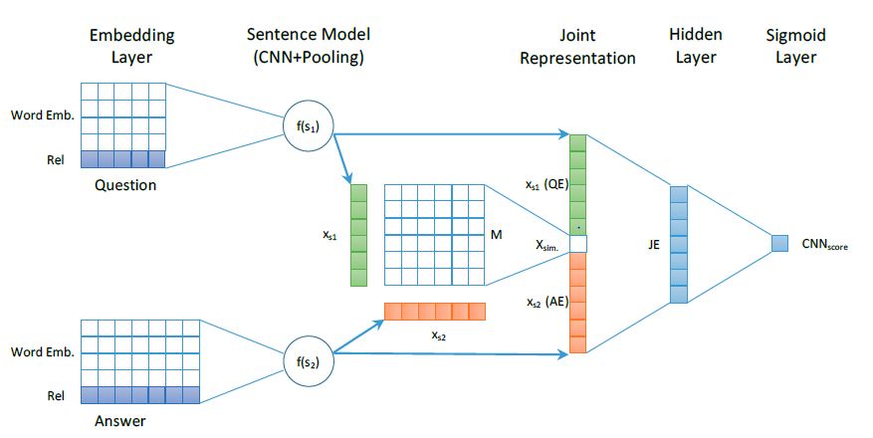
Feature Engineering for QA with CNNs
QE
QE
AE

Slide 15
Injecting Relational Information in CNNs
In the input sentence, using an additional word overlap indicator feature with each word.
Using an additional lookup table for the word overlap
features with parameters
For a word, its final embedding

Slide 16
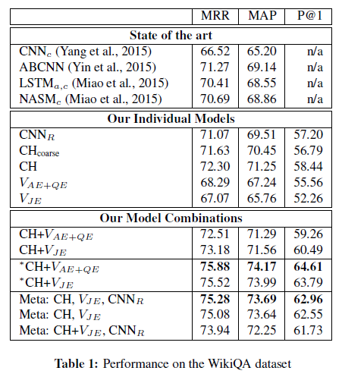
Experiments
CNNc is the Convolutional Neural Network with word count
ABCNN is the Attention-Based CNN
LSTMa,c is the long short-term memory network with attention and word count
NASMc is the neural answer selection model with word count
V is a polynomial SVM reranker

Slide 17
Conclusions
This paper compares two state-of-the-art feature engineering approaches, CTKs and CNNs whose have richer representation information.

